Slide 1
“Who Can Vote?”

Slide 2
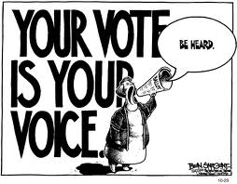
The Importance of Voting
Voting is a major civic responsibility.
Voting allows citizens to :
Choose their government leaders
Voice their opinions on past performances of public officials
Express their opinion on public issues
http://www.centeroncongress.org/one-vote

Slide 3
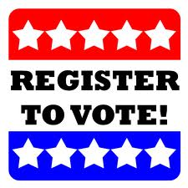
Voter Registration
You must register to vote before you can take part in an election in most states.
Exception: North Dakota
Registration applications may vary from state to state

Slide 4
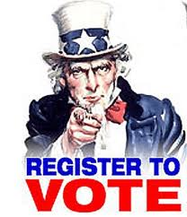
Voter Registration
In order to register in the state of Florida you must:
Be a citizen of the United States
Be a legal resident of both the state of Florida and of the county in which you are registering
Be 18 years old (you may pre-register if you are 17)
Be mentally capable of making decisions
Not have been convicted of a felony (unless the governor has restored your rights)
Register at least 29 days before the election takes place

Slide 5
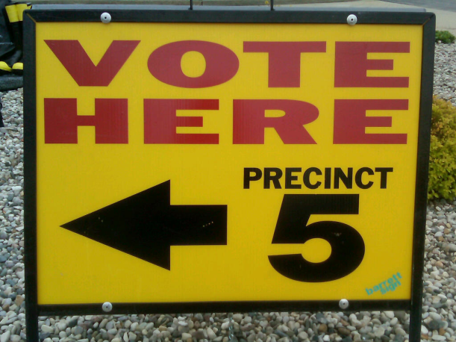
Steps in Voting
On Election Day, voters go to the polling place in their precinct, or voting district.

Slide 6
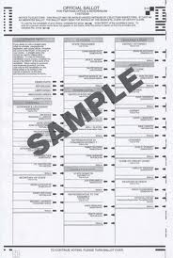
Steps in Voting
When you arrive you will go through a series of checks to confirm your identity, and confirm you are registered to vote.
Next you will receive a ballot, or list candidates on which you cast your vote.

Slide 7
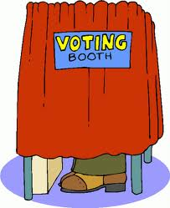
Steps in Voting
You will then go to the voting booth to cast your vote.

Slide 8
Steps in Voting
After the polls are closed, elections workers send the ballots and the results – called returns – to the election board.
The board then sends the returns to the state canvassing authority who then certifies the election of the winner.

